Slide 1
Old Saltleians RFC
New Start & 5 Year Plan
AGM 20 May 2022
Rev-1.0

Slide 2
Mission Statement
Old Saltleians Rugby Football Club aspires to honour it’s motto, inherited from the grammar school,
‘Spectemur Agendo!’
“Let us be judged by our actions!”
A welcoming, diverse and fully inclusive rugby club that aspires to support, encourage and reward our membership and guests to be the best they can be.
Promoting and supporting sustainability of rugby union and its Core Values.
A continuing mission with a new business plan for the next five years at Old Saltleians RFC

Slide 3
We have the future of rugby in our hands!
Fabulous new build rugby facility, to rival any in the Midlands
State of the art social areas, heated changing rooms with gym & physio room
A ‘Player Centric’ approach, with opportunities for adults, boys and girls from U6 to U18 to reach their potential in rugby.
Significant investment in coaches and volunteers, training courses and kit.
New facilities are impressive, bringing in more junior players, be prepared!
Family friendly environment underpinned by rugby’s core values of Teamwork, Respect, Enjoyment, Discipline and Sportsmanship
H.E.A.R.T. of rugby delivered to our 3 years to 8 years old micros & new players. Hand-eye coordination, Enjoyment, Agility, Respect, Teamwork!
New membership structure giving added value to our members
A big thank you to our members who have supported us during our exile.
Welcome back to our friends, whom we have missed and to new members.

Slide 4
Be Part of the Team! Shirt Sponsors Pitch side Boards Scoreboard plaques Match Day Sponsor – business lunch Sponsors Wall – recognition of our ‘team’ Partnerships are key to our future Electronic programmes! Watch it, be apart of it!
O’Brien Contractors Ltd.
Collection Pot Donors
Hathaway & Cope Life & Pensions
Party Time, Castle Bromwich
Water Orton Parish Council
Sport England - guidance
RFU - guidance

Slide 5
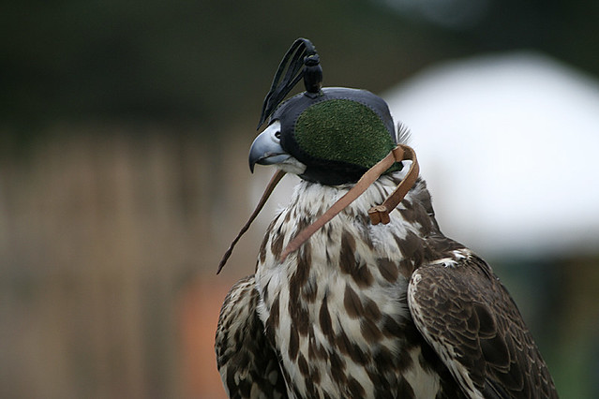
Without feedback we are flying blind! Feedback Matters!
Improve communications for members, parents and volunteers!
Efficient new membership Smart Cards/ and support management system. Shop and drinks with your card!
Partnerships’ development, sharing with our Sponsors!
Two year sponsorship deals with kit logos on all club kit.
One Club! Kit uniformity, senior & junior teams the same.
Increase investment and support to grow Women’s rugby, touch rugby and walking rugby!
More initiatives to recognize our volunteers!
Mobile catering unit pitch side for coffee/snacks!
Review 100 Club lotteries with other fundraising ideas!
Children's play area near the patio.
Fitness Trail around the perimeter of the grounds!
Gym structured to prioritize players fitness and still allow members to use the facility.

Slide 6
Rugby Strategy
One Club
Men’s, Women’s,
Veterans,
Mini & Youth,
Saltasaurus Micros,

Slide 7
Rugby Playing Structure
Director of Rugby
1st & 2nd XVs
Social XVs
Walking Rugby Touch Rugby
Womens XV
Colts U18
Sabres U16
Youth Rugby Coaches
Youth section U13-U17
Mini Section U6-U12
Saltasaurus (3 to U8)
Chairman of Mini and Youth Rugby

Slide 8
Men’s & Women’s: 1 to 5-year goals
Mens 1st XV, Stabilise at Level 7, target promotion to and stabilise at Level 6!
Create a Womens team, become the club of choice for female rugby players
Build a legacy of continued referee development & participation.
Recruitment of players to stabilise and develop the Social XVs.
Accommodate Veterans Rugby, Touch Rugby, Walking Rugby.
Become the Community Rugby Club of Choice in Greater Birmingham
Year 1
Y1 – What does failure look like –
1st Mens XV relegation 2022/23,
2nd Mens XV play less than 25% of weekends
Failure to create a women’s team.
No Veterans Rugby fixtures
Y1 – What does success look like –
1st Mens XV Win more than we lose at Level 7.
2nd Mens XV play more than 50% of weekends,
Women team(s) with stable membership play 25% of weekends.
Veterans play 4+ games.

Slide 9
Year 2
Y2 – What does failure look like –
1st Mens XV lose more games than they win 2023/24,
2nd Mens XV play less than 50% of weekends
Women’s team play less than 50% of weekends.
Veterans Rugby less than 4 fixtures
No Touch Rugby
No Walking Rugby
Y2 – What does success look like –
1st XV Top 4 in the league at Level 7.
2nd XV play more than 75% of weekends.
Women team(s) with increased and stable membership, play more than 50% of weekends.
Veterans Rugby play 8 fixtures
Touch League enrolment.
Walking Rugby regularly played.

Slide 10
Mini & Youth : 1 to 5-year goals
Recruit Managers and Coaches.
Continue to grow the numbers of boys and girls playing rugby at Old Saltleians RFC
Build a legacy of continued participation opportunities for girls and boys in rugby through 'Saltasaurus’ to Colts & Sabres. Develop the pathway to AGR.
Develop a pathway for U16 girls and U18 boys to transition to senior rugby at Old Saltleians RFC and beyond.
Develop a Referees Pathway to senior referee qualification.
Meet RFU Safeguarding values and best practice standards to support coaches, referees, players & volunteers.
Recognize and demonstrate how we value our volunteers.
Formalize links with North Warwickshire, East Birmingham and North Solihull schools and create opportunities for children to experience and enjoy rugby at Old Saltleians RFC
Increase female participation with two teams regularly playing.
Mini & Saltasaurus integration is smooth

Slide 11
Year 1
Y1 – What does failure look like –
Failure to create a girls’ team.
No contact with local schools.
No young referees recruited, no pathway.
Youth development stalls, no significant increase in numbers, less than 3 teams created.
Saltasaurus falters, no increase in numbers.
Y1 – What does success look like –
Girls team(s) with stable membership.
A contact established at each of the North Warwickshire, East Birmingham and North Solihull Schools.
3 Young referees recruited and pathway established
U-17, U15, U13 boys youth teams, U11, U9 minis,
Saltasaurus grows to 20 members.

Slide 12
Year 2
Y2 – What does failure look like –
No age grade managers for each team
Girls’ team play less than 50% of weekends.
Young referees fail to continue
Mini & Youth development, no significant increase in numbers, less than 1 team in every other age group.
M&Y Coach numbers fail to achieve 1 coach per every two age groups.
Saltasaurus continue with 15 or less children.
Y2 – What does success look like –
Each age grade team has a manager.
Girls team(s) with increased and stable membership, girls at U13, U15 & Sabres at U16.
Young referees on pathway, one at each age grade.
Youth players rotate to experience refereeing at an age grade two below their age.
There are two M&Y Coaches at each age level.
Boys U-18, U16, U15, U14, U13 youth teams, U11, U10, U9, U8, U7 minis,
Saltasaurus grows to 30 members.

Slide 13
Operations
Commercial and Social

Slide 14
Start Up – The Plan & The Budget
Determined the Start-Up Budget and assessed sustainable annual costs and created a 5 year Budgetary Forecast.
Sustainability – We have developed the philosophy & tools to keep a cap on energy costs.
Sustainability – Recruitment MUST be managed with club player leaders team actively engaging new players. Director of Rugby is tasked to focus on regeneration of players.
New Website & enhanced EPoS, Smart Cards with membership data and communications.
Contract and/or agreements
Kit suppliers Akuma & shop
Beer & Gas, other consumables providers, snacks & beverages.
‘Langley’ EPoS contract entered into.
1st & 2nd XV Kit Sponsorship, focal point, year 1 & 2
2 year deal for sponsors on ALL playing kit & player leisure stash!
Pitch board ‘Drive’ to create the ‘Arena Effect’
Rolling Deal 1 to 5 years, renewal
Post Pads sponsorship
5 year deal for pitch one post pads.
Player Sponsorship
Structure Junior Team Sponsorship,
kit will remain a singular One Club design with partners logos!
Host Mini and Junior end of season Festivals

Slide 15
Membership & Registration
Membership is defined in compliance with the ‘The Club Rules’ and comprises four profiles in two groups.
Voting Member.
Full Member, the credentials are defined in ‘The Club Rules’ to protect and manage the club and includes Vice Presidents and Life Members. Eligible to apply for International Tickets from the club’s allocation.
Non-Voting Member.
Associate Member. Eligible to apply for International Tickets from the club’s allocation.
Youth Member. (player under 18 years old)
Social Member.
The Club Rules are amended from time to time and are available to all members.
Players who represent the club at any level must be RFU Registered and either Youth, Associate or Full Members. Social Members do not need to be Registered with the RFU.
For 2022/23 season, the Membership is £80 p.a. or £21 x 4 instalments. Exceptions are……
Youth Membership is FREE. Each U18 player must be registered with the club and with the RFU by a Member, who is their Parent or Guardian.
Social Membership is £40 pa or £12 x 4 instalments.
Smart Membership Cards will be issued to all adult members, these cards must be charged with funds to enable discounts at the bar and kitchen.
Youth Members will be not be issued with a Smart Card.

Slide 16
Medium to Long Term
Create Schools Partnerships
Assess Planning Conditions, identify if there are unnecessary restrictions, mis-reads!
Work in partnership with our community, host Water Orton Carnival 2023
Set up Member Patrons scheme
Marquee/Patio covering
Mobile catering unit pitch side
Regular Members’ Events:
Fun Days and Fetes
Wine Tasting evenings
Beer Festival
Broadcast International Rugby Fixtures on TV
Outdoor Digital Scoreboard with Advertising Revenue Stream
To consider non-member events with respect to Planning Conditions
Summer Rugby Tournaments – 7s / Charity / Forces
Seasonal Balls/Presentations

Slide 17
Five year commercial forecast
Modest income forecast in years 1 to 2 with restart capex impacts and estimated incomes.
Considerable increases in energy costs to accommodate in the budgets.
Optimistic growth of income 7.5% to 8% in years 3 to 5 as we drive our commercial planning.
Summary | Year 1 | Year 2 | Year 3 | Year 4 | Year 5
Total Income | 71,400 | 78,720 | 84,572 | 91,009 | 98,090
Total expenditure | 79,185 | 80,931 | 84,421 | 88,169 | 92,199
Income less expenditure (before capex) | (7,785) | (2,211) | 151 | 2,840 | 5,891
Total capex | 16,850 | 1,500 | 1,500 | 1,500 | 1,500
Income less expenditure (after capex) | (24,635) | (3,711) | (1,349) | 1,340 | 4,391
Year 1 bar stock outlay | (5,000)
 | (29,635)

Slide 18
Looking ahead
Community amateur rugby club, maintenance of our status
Core rugby community activities
Low risk goals in rugby and development
Recognised and compliant to the RFU and HMRC
Ensuring long term sustainability of the clubhouse and pitches
Allocate £1.5k per annum (year 2-5) to the club maintenance capital expenditure
Allocate £1k per annum to the tractor amortisation and maintenance
Allocate £4k per annum (year 3-5) on pitch refurbishment, chemicals and aeriation.
Bar Income to generate budget for all sustainability costs, then the surplus to supplement rugby activities and enhanced membership experience.
Sponsorship to generate budget for all rugby activities and enhanced membership experience.
Every single pound of profit generated will continue to be invested straight back into our club’s rugby activities

Slide 19
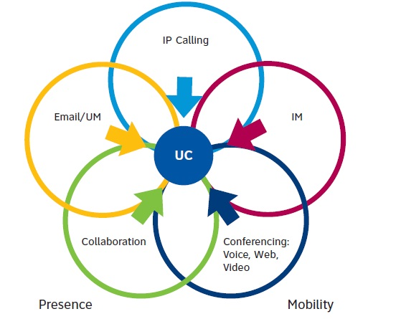
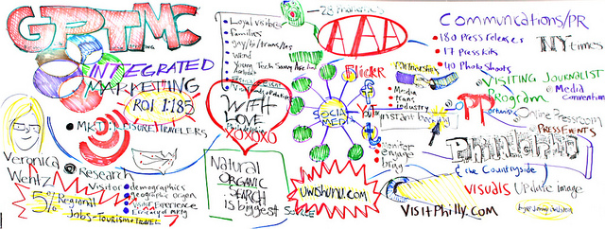
Improving Old Salts communications
We recognize that, during COVID lockdowns and our exile, communications were minimalistic across our members, voluntary groups and committees. Apart from discovering Zoom it was negative!
Going forward, we need to improve how we communicate and will develop a communications plan within the new managed website.
Volunteers are key to help us to grow internal and external communications across all our club and social media channels including Facebook, YouTube, Instagram, TikTok
Website connectivity through emails direct to members and social media for generic communications!
Meet, talk, decide!
Think, write, send!

Slide 20
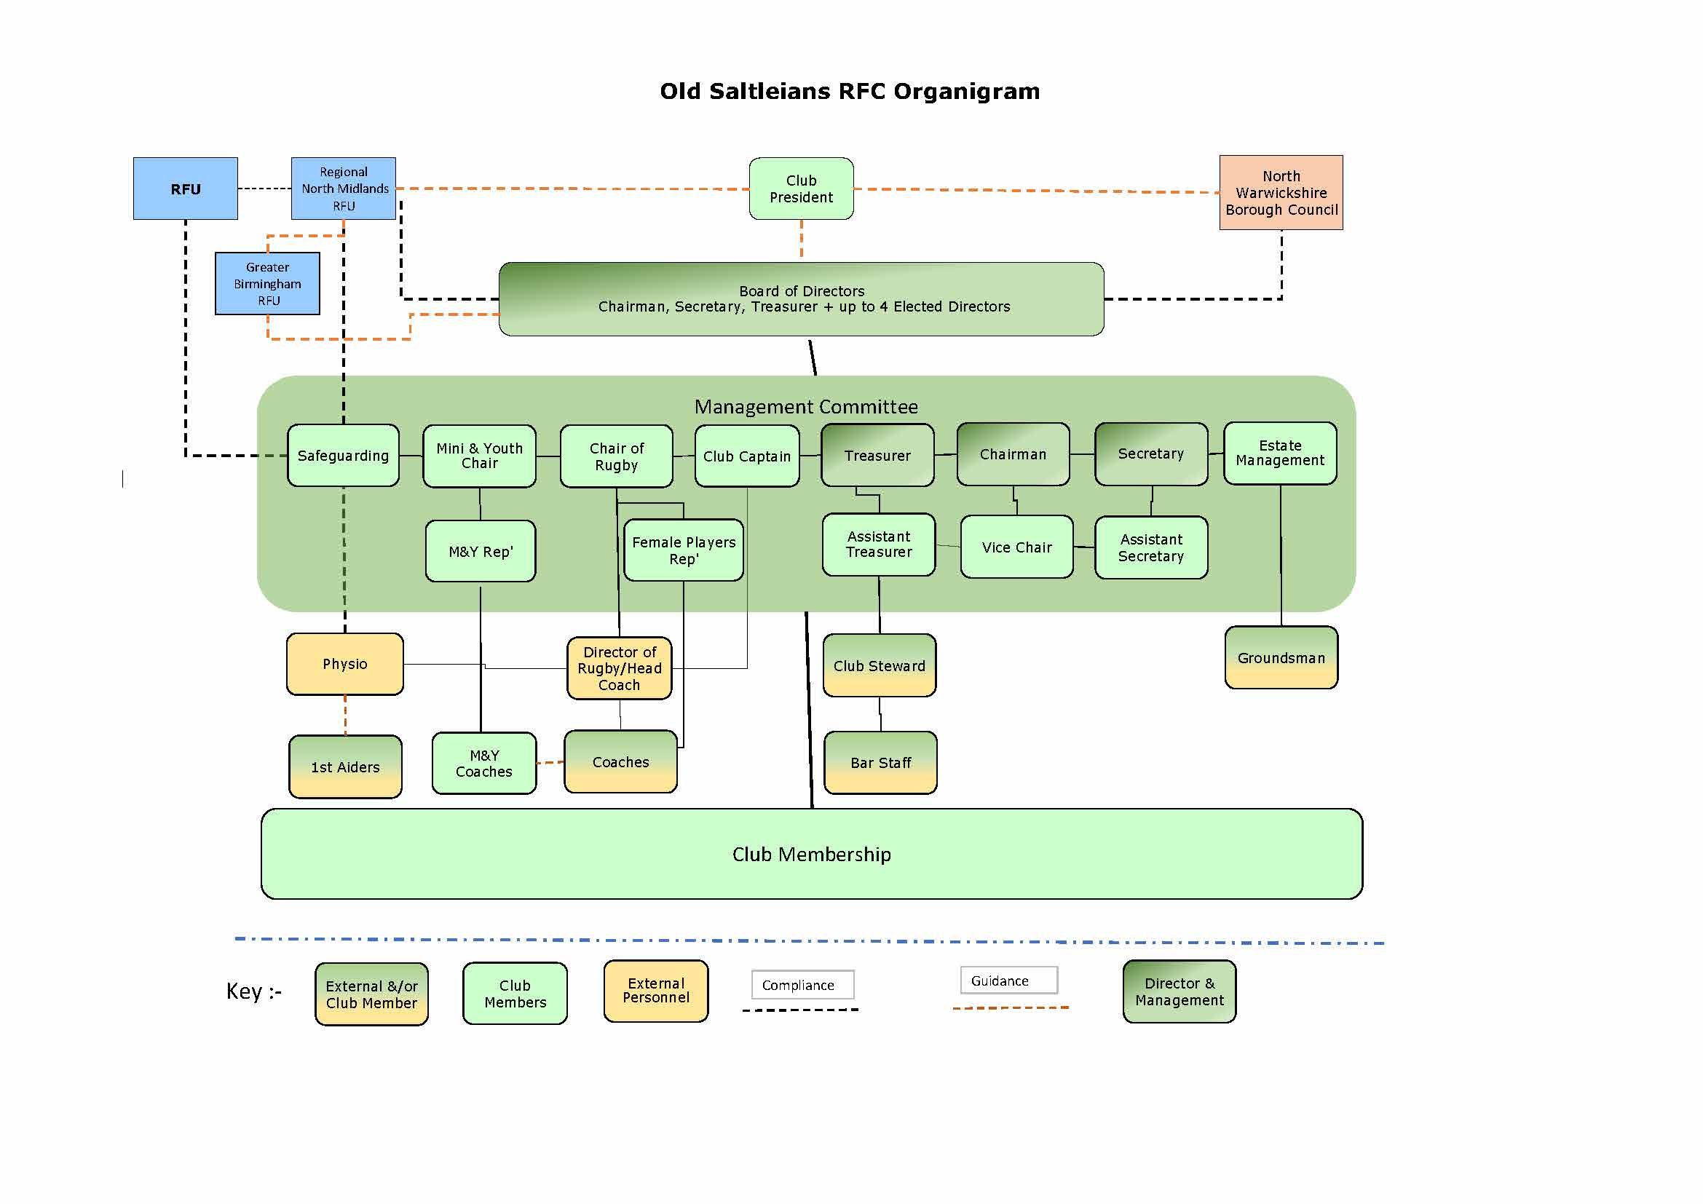

Slide 21
Thank you!
The club needs you and appreciates your time
We welcome your questions

